Slide 1

DSO 510: Business Analytics Project
Investigating Crime and Rental Prices
Dimitra Charalampopoulou, Saier (Sam) Hu,
Chris Leung, Kai Hoffmann, Nicoletta Ziozis, Brittany Sims

Slide 2
Problem Statement
Investigating the impact of crimes per capita on average rent prices in 51 major US cities

Slide 3
Our Hypothesis
H0: Crimes per capita does NOT have an impact on average rent prices
Ha: Crimes per capita does have an impact on rent prices

Slide 4
Why do we need a data driven approach?
Our intuition is that higher crime rates -> drive rental prices lower
However,
High crime rates may be correlated with other confounding factors such as population, unemployment rates etc., which cause rental prices to be lower

Slide 5
Why do we need a data driven approach?
Real-estate developers who seek to build new apartment buildings
Real-estate investors who might track crime figures to signal investment opportunities
Municipal law enforcement agencies can benefit from our study as they try to monitor illegal activities, in that a decrease in rental rates might signal an increase in criminal activities

Slide 6
Ideal Experiment
Control Group Experiment/ AB Testing: Crime rates over time
Low Crime Rates → High Crime Rates
High Crime Rates → Low Crime Rates
Low Crime Rates → Low Crime Rates
High Crime Rates → High Crime Rates

Slide 7
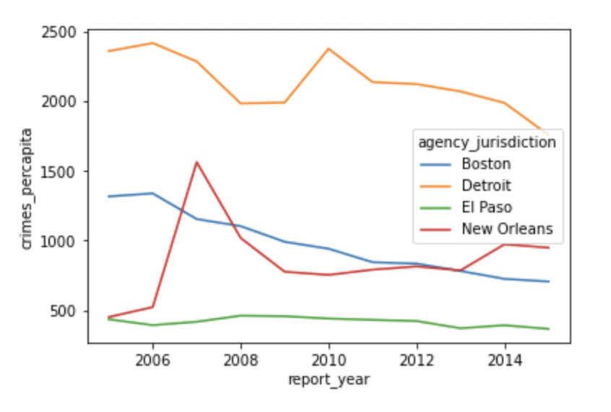
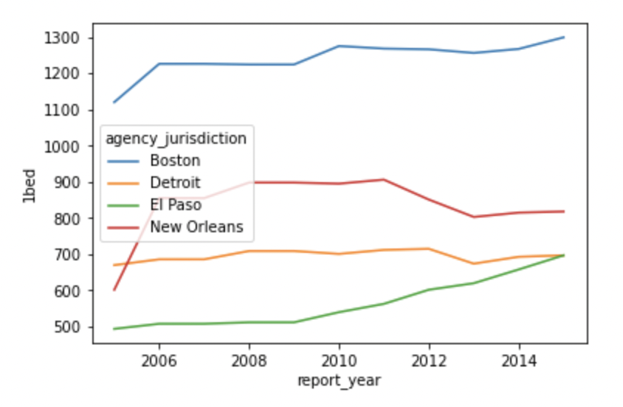
Ideal Experiment
New Orleans (Low Crime Rates → High Crime Rates)
Detroit (High Crime Rates → Low Crime Rates)
El Paso (Low Crime Rates → Low Crime Rates)
Boston (High Crime Rates → High Crime Rates)

Slide 8
Our Data
4 Different Datasets per City from 2005-2015 :
Analysis of US Crime Data - Kaggle Data Set
Apartment Rent Prices Data - Office of policy development and research
Unemployment data - US Bureau of Labor Statistics
Median Household Income Data - US Census Dataset

Slide 9
Data Cleaning
● Flipping the rows and columns in the CSV file since they are not written in a dataframe format: df.T()
● Set blank values as Null values: df.replace(r'^\s*$', np.nan, regex=True)
● Inspecting Null values in the dataset: df.isna().sum()
● Removing Null values: df.dropna()
● Removing irrelevant columns in the datasets: df[df.columns.drop(list(df.filter(regex=‘SomeString’)))]
● Merging datasets by matching Year, State, and City

Slide 10
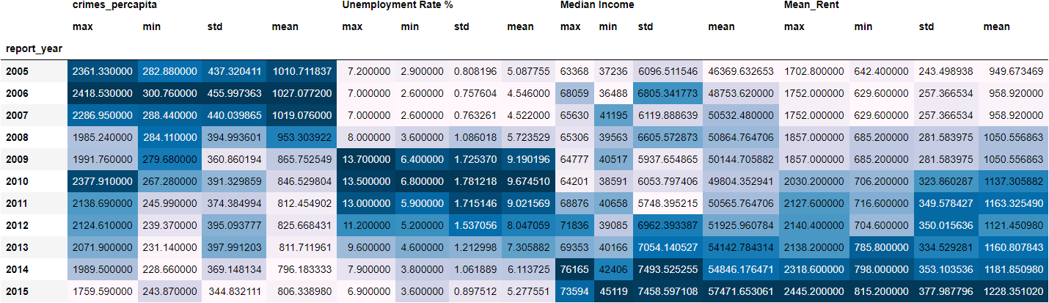
Descriptive Statistics Summary

Slide 11
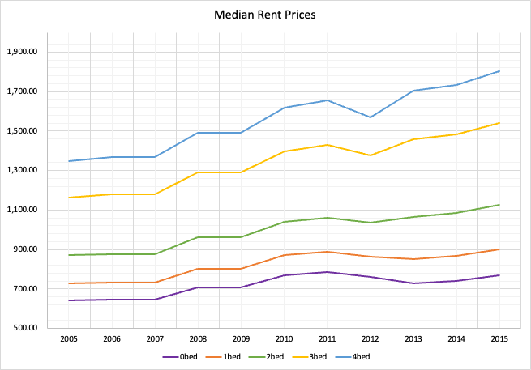
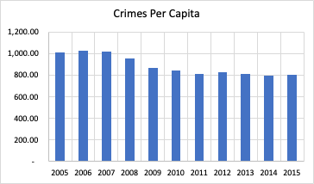
Visualizations - Crime & Rent

Slide 12
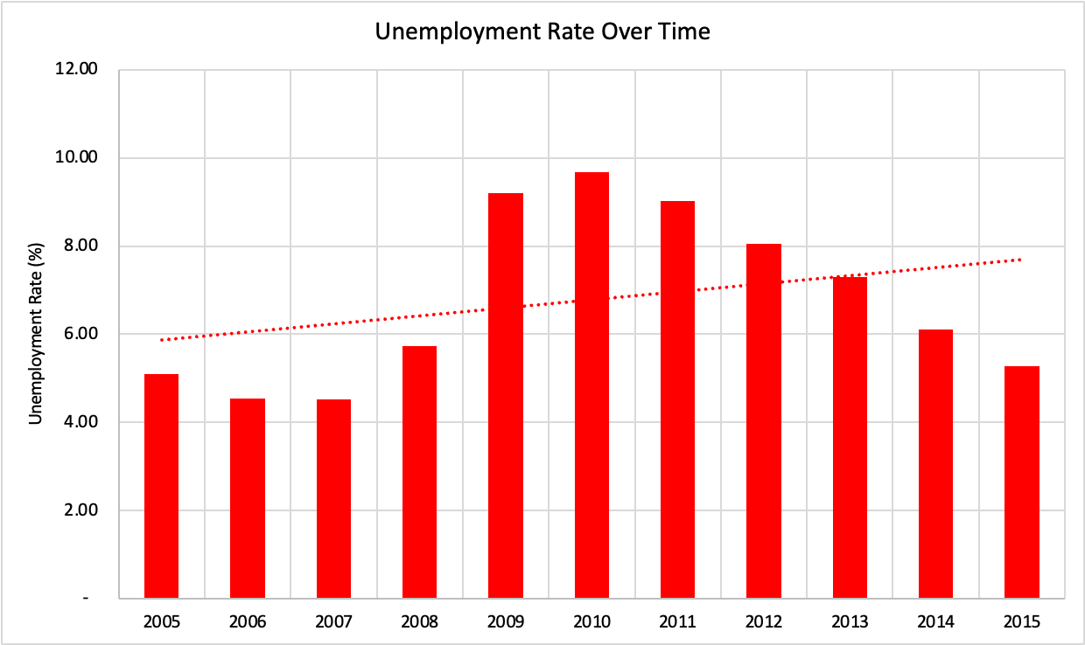
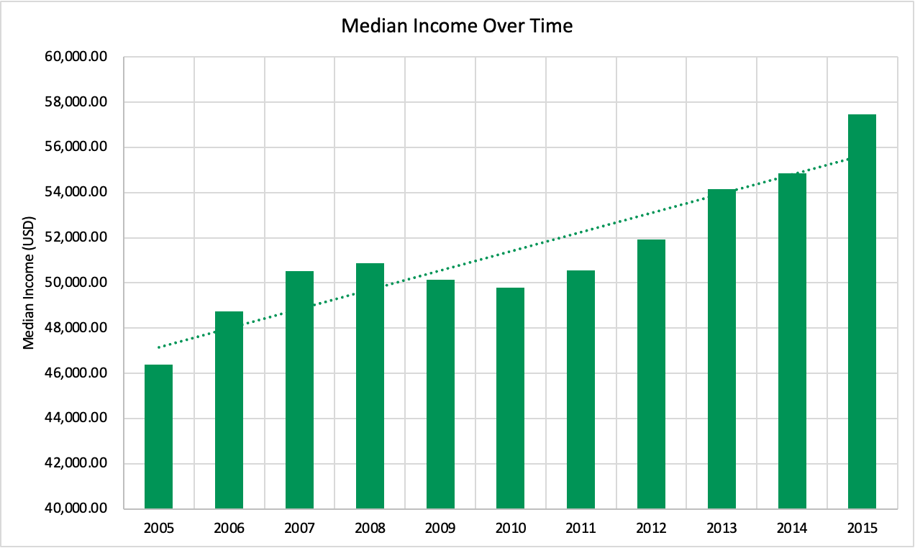
Visualizations - Unemployment & Income

Slide 13
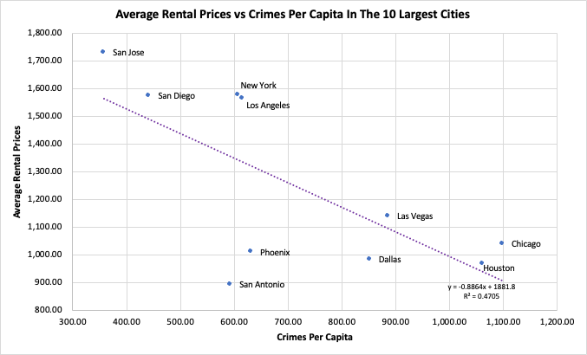
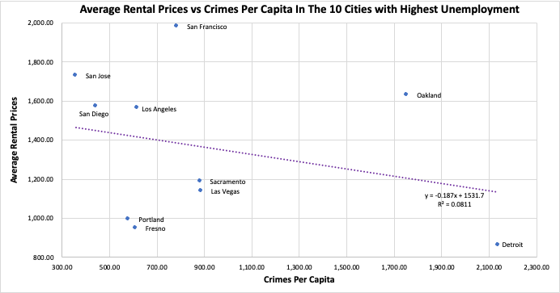
Visualizations - Crime & Rent

Slide 14
Our Analysis

Slide 15
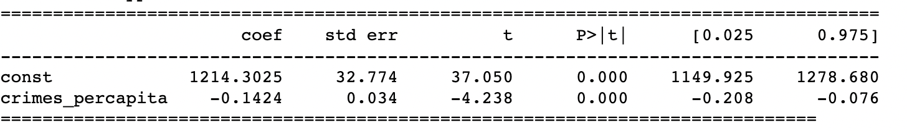
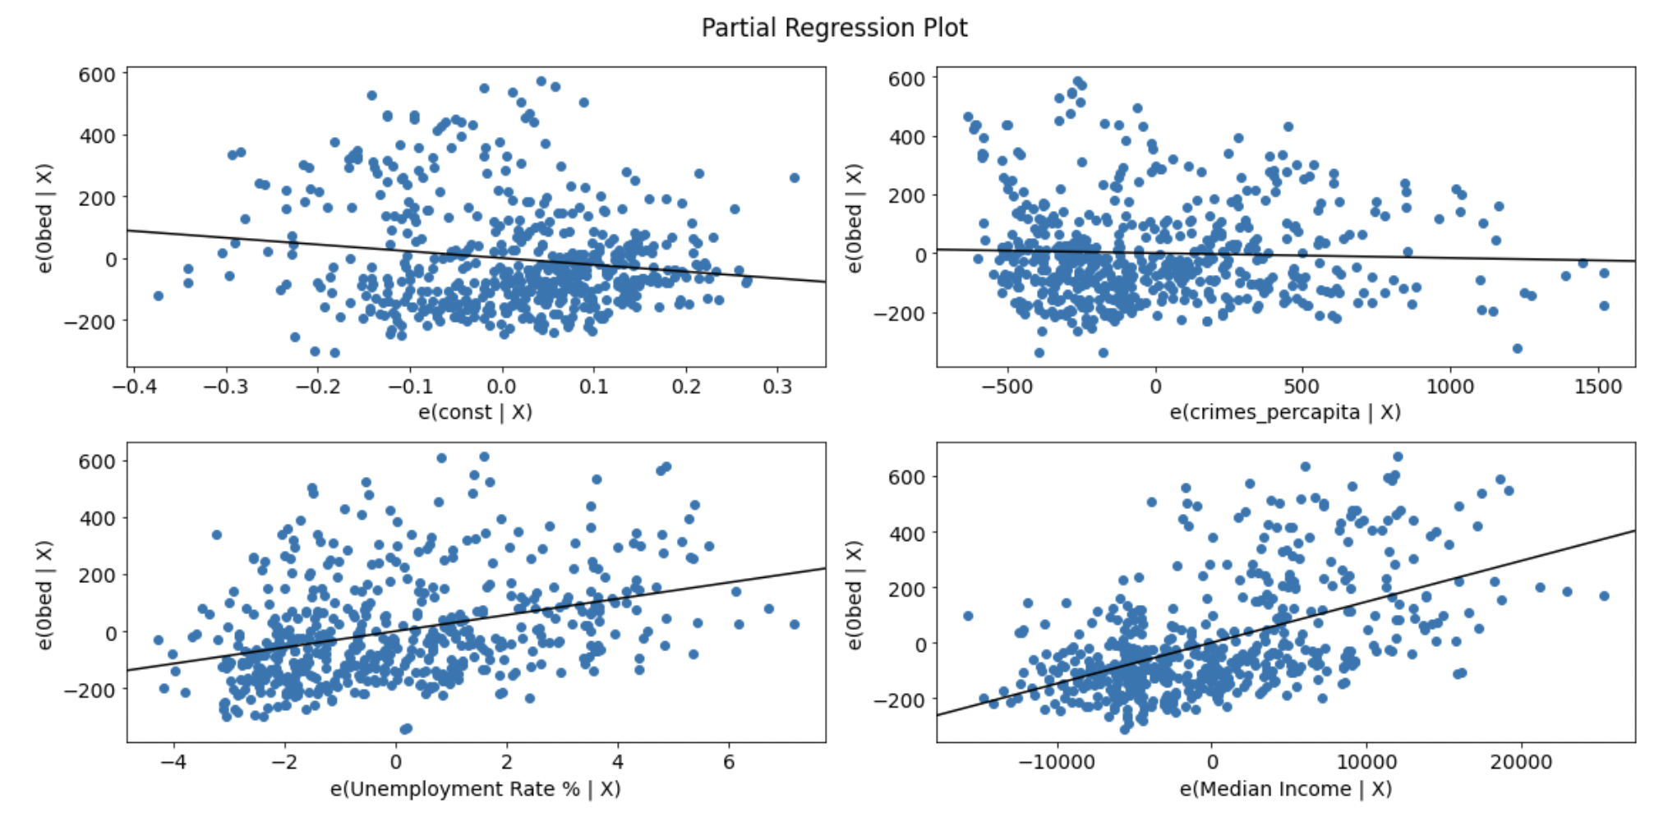
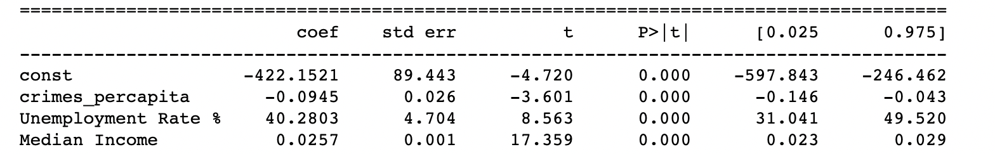
Analysis: Simple Regression
Average_rent = bo + b1*crimes_percapita
H₀: Crime has no effect on average rent for apartments
H_{a}: Crime Does have an affect on average rent for apartments
Average_rent = bo + b1*crimes_percapita + b2*Unemployment rate + b3*Median Income
H₀: Crime has no effect on average rent for apartments, controlling for unemployment and median income
H_{a}: Crime Does have an affect on average rent for apartments, controlling for unemployment and median income

Slide 16
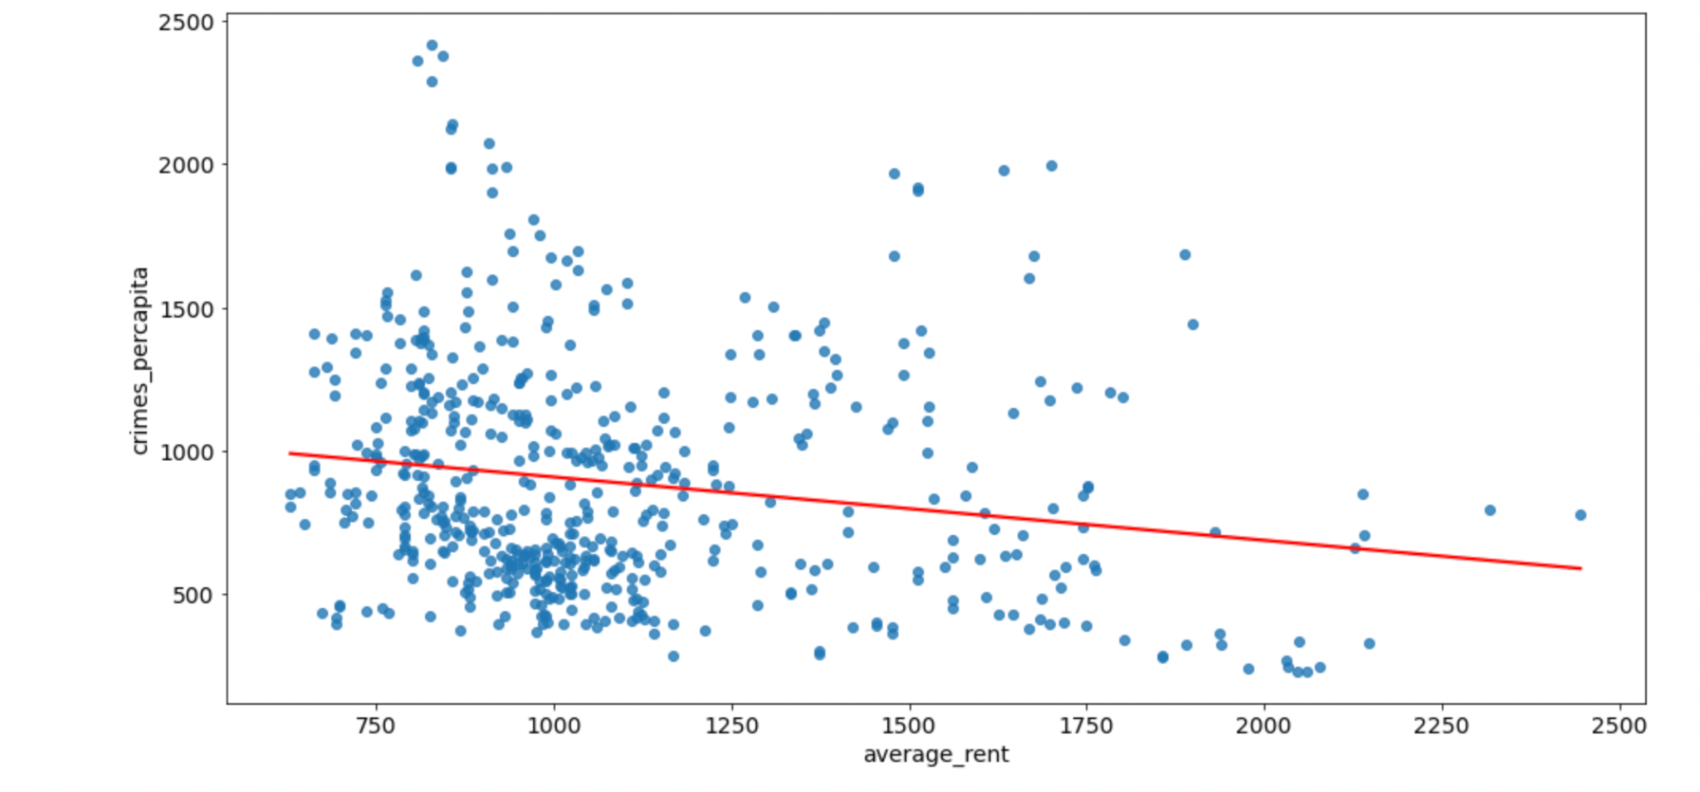
Analysis: Simple Regression
Y axis fix

Slide 17
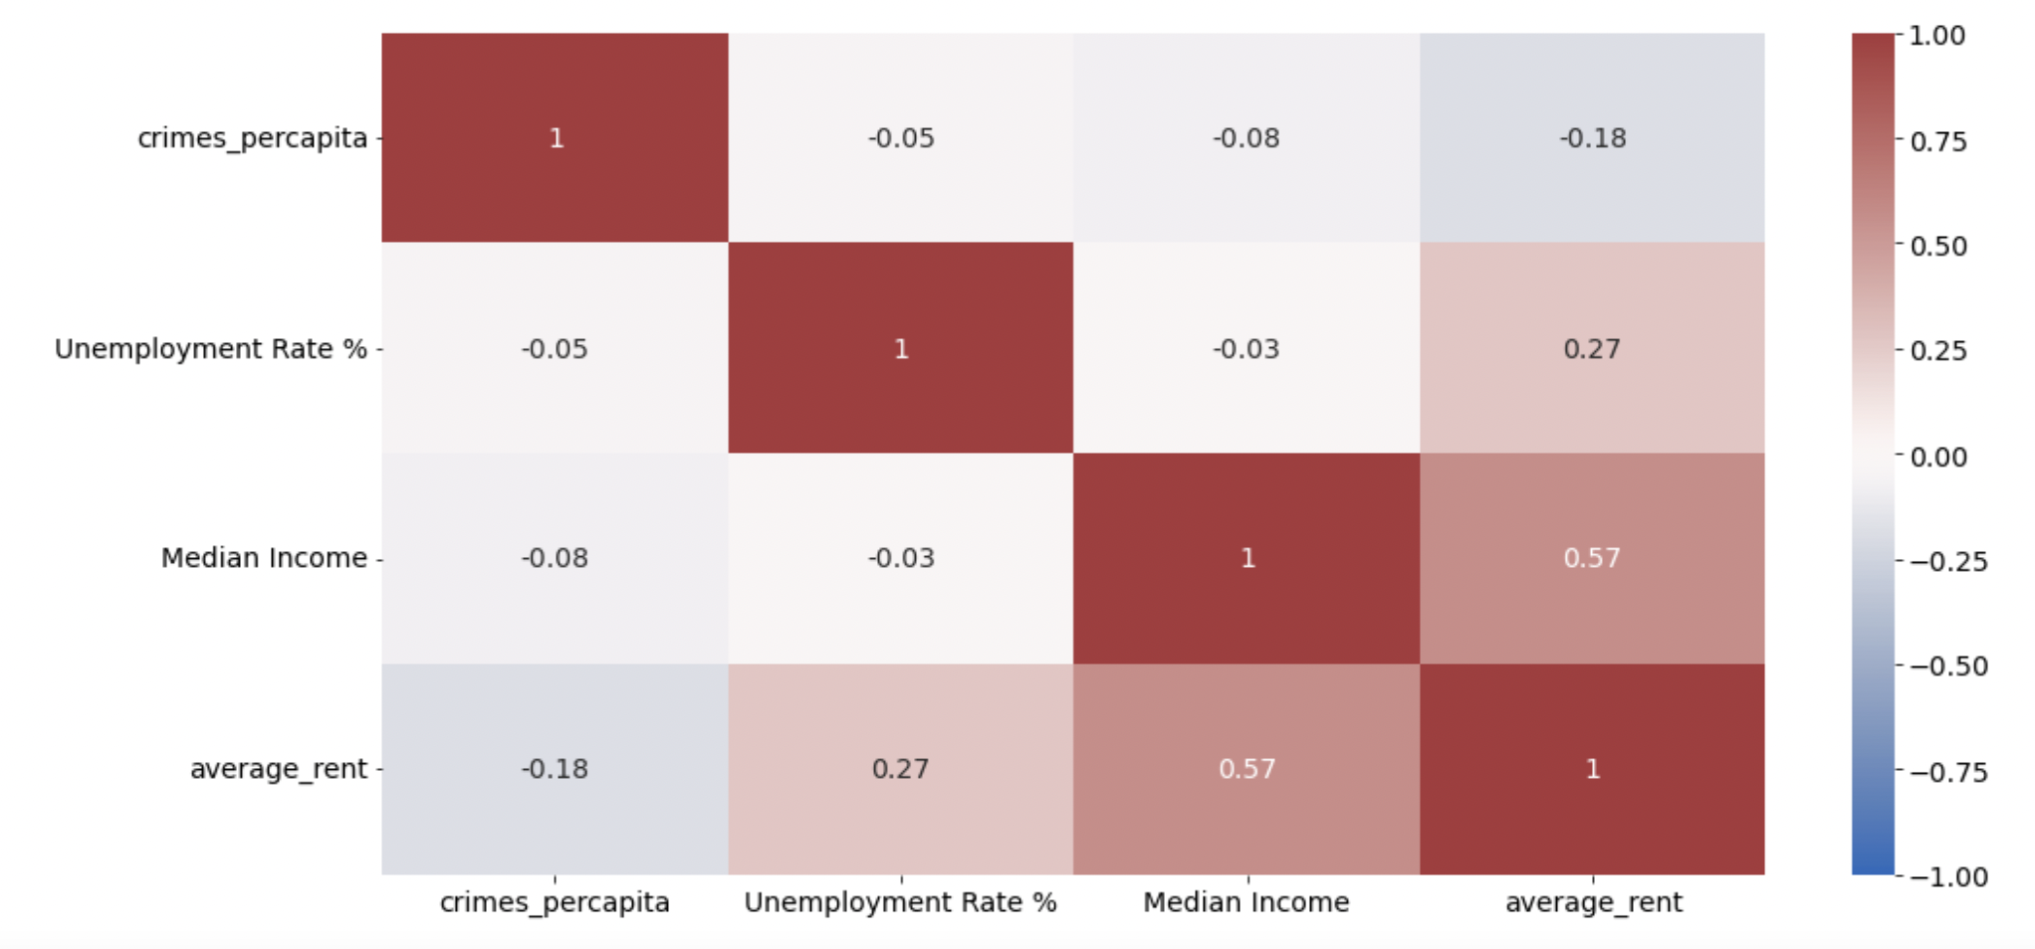
Analysis: Simple Regression

Slide 18
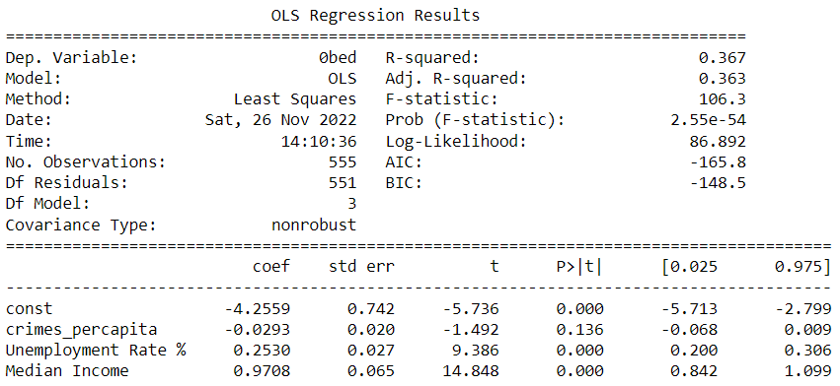
Analysis: Regression for Studio Apartments
log(Rent_0_Bed)= bo + b1*log(crimes_percapita) + b2*log(Unemployment rate) + b3*log(Median Income)
H₀: Crime has no effect on rent for 0 Bedroom Apartments, controlling for unemployment and median income
H_{a}: Crime Does have an affect on rent for 0 Bedroom Apartments, controlling for unemployment and median income
Fail to reject the null hypothesis:
the p-value for crimes per capita at a significance level of 10%

Slide 19
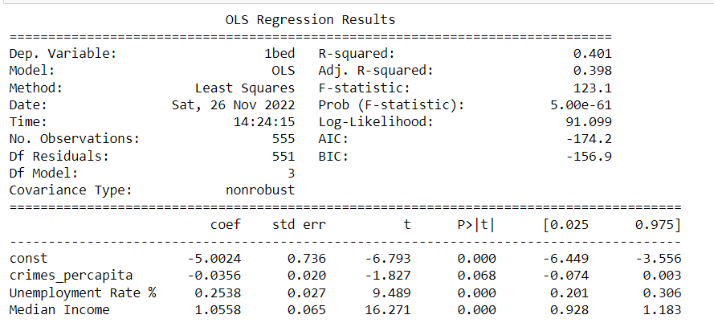
Analysis: Regression for 1 Bed Apartments
log(Rent_1_Bed)= bo + b1*log(crimes_percapita) + b2*log(Unemployment rate) + b3*log(Median Income)
H₀: Crime has no effect on rent for 1 Bedroom Apartments, controlling for unemployment and median income
H_{a}: Crime Does have an affect on rent for 1 Bedroom Apartments, controlling for unemployment and median income
Fail to reject null hypothesis the null hypothesis at a significance level of 5%

Slide 20
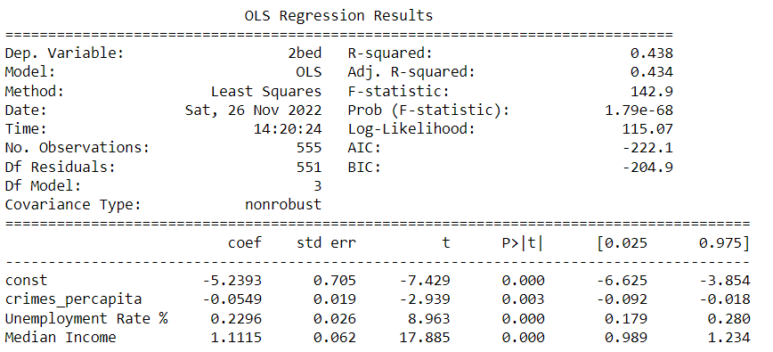
Analysis: Regression for 2 Bed Apartments
log(Rent_2_Beds)= bo + b1*log(crimes_percapita) + b2*log(Unemployment rate) + b3*log(Median Income)
H₀: Crime has no effect on rent for 2 Bedroom Apartments, controlling for unemployment and median income
H_{a}: Crime Does have an affect on rent for 2 Bedroom Apartments, controlling for unemployment and median income
Reject Null Hypothesis at a significance level of 5%

Slide 21
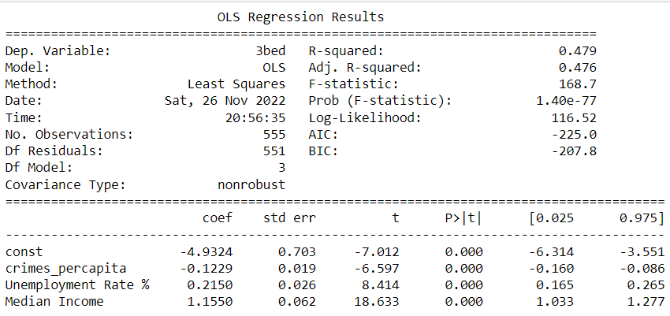
Analysis: Regression for 3 Bed Apartments
log(Rent_3_Beds)= bo + b1*log(crimes_percapita) + b2*log(Unemployment rate) + b3*log(Median Income)
H₀: Crime has no effect on rent for 3 Bedroom Apartments, controlling for unemployment and median income
H_{a}: Crime Does have an affect on rent for 3 Bedroom Apartments, controlling for unemployment and median income
Reject Null Hypothesis at a significance level of 5%

Slide 22
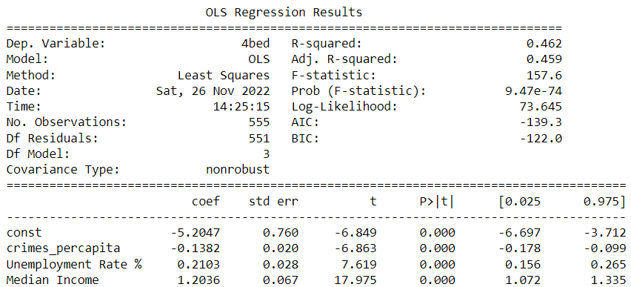
Analysis: Regression for 4 Bed Apartments
log(Rent_4_Beds)= bo + b1*log(crimes_percapita) + b2*log(Unemployment rate) + b3*log(Median Income)
H₀: Crime has no effect on rent for 4 Bedroom Apartments, controlling for unemployment and median income
H_{a}: Crime Does have an affect on rent for 4 Bedroom Apartments, controlling for unemployment and median income
Reject Null Hypothesis at a significance level of 5%

Slide 23
Conclusion
If we look at average rent across different apartment types in the 51 major cities from 2005-2015, we reject the null hypothesis that crimes per capita does not have an impact on average rent prices.
i.e. We find out that crimes per capita has an effect on average rent prices. Moreover, we find out that crimes per capita negatively affects average rent prices.

Slide 24
Limitations
More census data
Focus on crime hot spots (neighborhoods) instead of the whole city
Focus on specific kind of crimes and their correlation with rent prices (e.g. property crimes may be correlated with rent more than other kind of crimes)
Try to mimic ideal experiments

